Slide 1
Modeling Effect of Coriolis Force on long range ballistics
Lilly, Luke, Koen

Slide 2
Table Of contents
Introduction
Building the Model
Conclusion

Slide 3
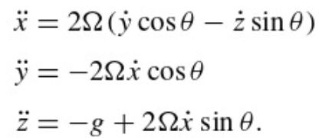
Introduction
Goal: Make a simple model on the effects the coriolis force has on long range ballistics.
Our scenario is two battleships on the ocean, one named the SS Happiness (Ship A) , the other is named SS Frank Homework (Ship B). Ship A is firing a missile at Ship B.
Fig. 1 Acceleration Equations (9.53) from Taylor

Slide 4
Building The Model - What are we doing
Model 1 -Not accounting for coriolis force
Model 2 -Accounting for coriolis force
Model 3- Moving Enemy ship

Slide 5
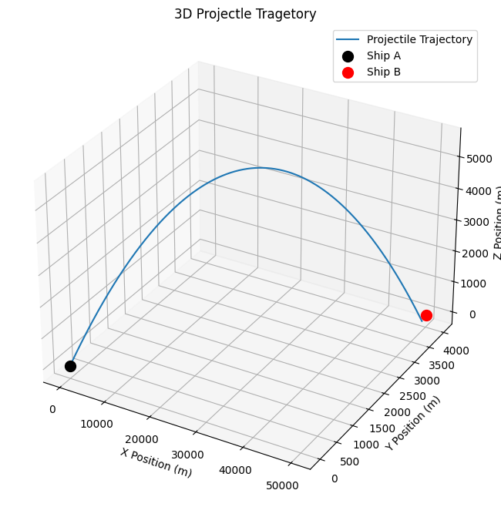
Fixed Model Without Coriolis Correction (Model 1)
Assumptions
Fixed ship position
Colatitude of Ship A: 30 degrees
X position of Ship b: 50km
y position of Ship b: 4km
If within +/- 20 meters in X and Y, and -5 to +30 in Z count as a hit
Constants
V₀ Rocket = 820 m/s
g = 9.8m/s
mass = 1225 kg
𝛀 = 7.3*10⁻⁵ rad/s

Slide 6
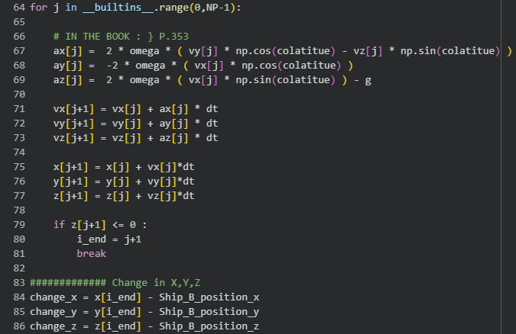
Model 1 Code
Notes:
To model the motion of the projectile we used the Euler’s method.
We started by setting up the libraries, constants, and inputs for positions of both ships.
Then set up empty data arrays for acceleration, velocity, position
Then iterate through using the acceleration equations from the book for coriolis force
Breaks out of loop when z value hits zero
Uses the last value from the iteration to calculate the shift between where we aimed and were it hit.
Graphs to show how far off from where you aimed it lands

Slide 7
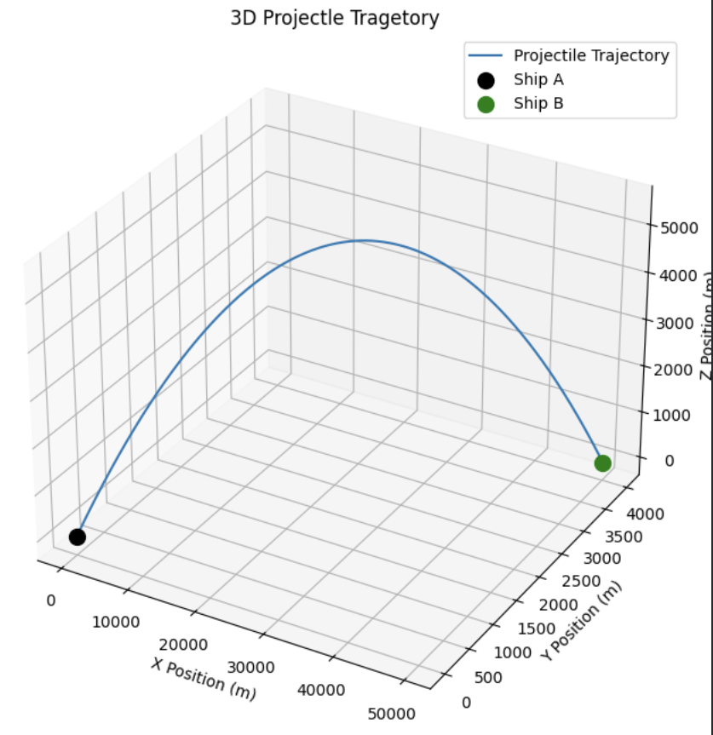
Fixed Model With Coriolis Correction (Model 2)
Assumptions
Fixed ship position
Colatitude of Ship A: 30 degrees
X position of Ship b: 50km
y position of Ship b: 4km
If within +/- 20 meters in X and Y, and -5 to +30 in Z count as a hit
Constants
V₀ Rocket = 820 m/s
g = 9.8m/s
mass = 1225 kg
𝛀 = 7.3*10⁻⁵ rad/s

Slide 8
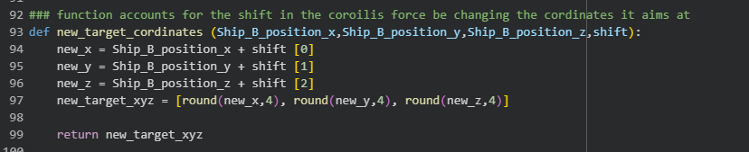
Model 2 Code
Notes:
This is a new function we wrote for part 2 to account for the shift
Uses the shifted value to calculate new aiming cordinates

Slide 9
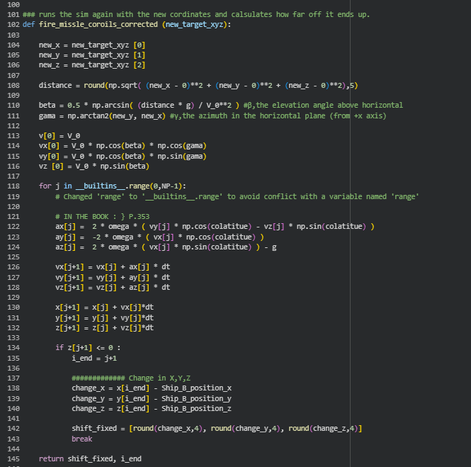
Model 2 Code
Notes:
This is a new function we wrote for part 2 to account for the shift
Still uses the Euler Method
Uses the new aiming coordinates to reiterate through using the acceleration equations from the book for coriolis force
Breaks out of loop when z value hits zero
Uses the last value from the iteration to calculate the shift between where we aimed and were it hit.
Then it graphs, the before and after of coriolis shift.

Slide 10
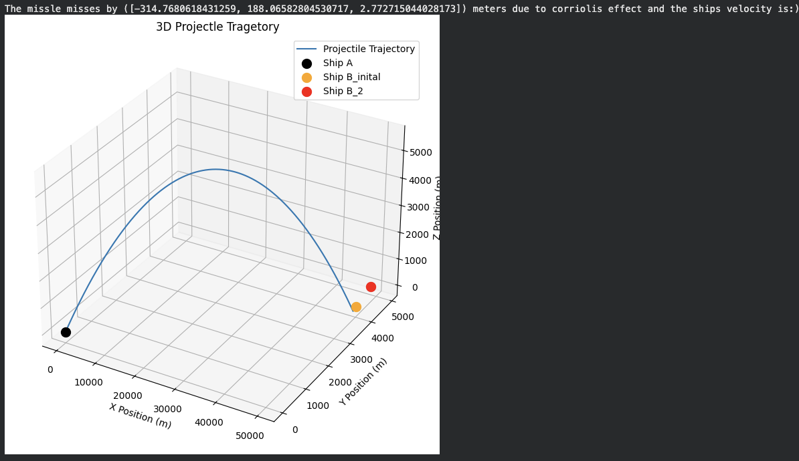
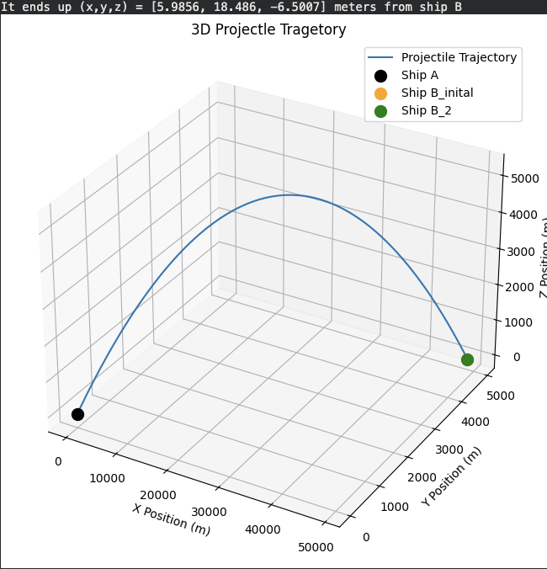
Moving Enemy Ships (Model 3)
Assumptions
Ship B moving at
Colatitude of Ship A: 30 degrees
X position of Ship b: 50km
y position of Ship b: 4km
If within +/- 20 meters in X and Y, and -5 to +30 in Z count as a hit
Constants
V₀ Rocket = 820 m/s
V₀Ship= 19m/s in X and Y
g = 9.8m/s
mass = 1225 kg
𝛀 = 7.3*10⁻⁵ rad/s
Notes:
Back to model 1 (no coriolis)

Slide 11
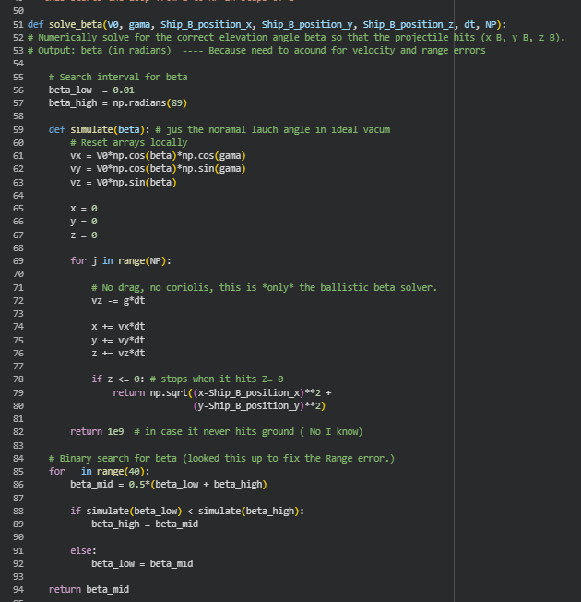
Model 3 Code
Notes:
Solving for beta
Had to iterate through all possible launch angles
spits out the right launch angle so nothing crashes

Slide 12
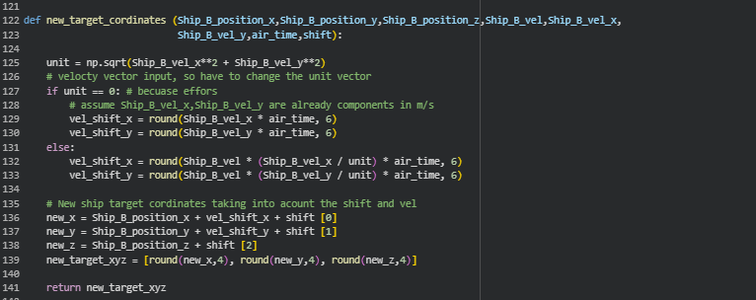
Model 3 Code
Notes:
This is like the other target function where it finds the new coordinates, but it accounts for the:
Coriolis,
Velocity
Then you can run the projectile code again and it will print graphs and tell you how far off you are.

Slide 13
Results
Managed to make an introductory model for modeling the effect the coriolis force has on battleships engagements. Building up from a simplistic model of no movement allowed us to slowly work to a more complicated model, that was a successful
As scientist its important to note the improvements that could be made:
  Need to add drag and other possible effects into the simulation
  Assumes constant velocities for ship and missile, which isn’t truly realistic

Slide 14
References
Taylor, John R. Classical Mechanics. University Science Books, 2005.
https://allhands.navy.mil/Features/Zumwalt/
“Full History: Battleship New Jersey.” Battleship New Jersey |, 10 Mar. 2025, www.battleshipnewjersey.org/the-ship/full-history/#:~:text=USS%20New%20Jersey%20has%20an,with%20approximately%201%2C100%20individual%20compartments.

